Slide 1
Data Mining Mini Project
Classification on Data-set of Transactions of a bakery
Shivani Shinde B150204383
Asmita Walunj B150204403
Shalaka Wikhe B150204404
Rasika Yelpale B150204405

Slide 2
Problem Statement
Apply any 3 classification algorithms on dataset of Transactions in a bakery. Calculate confusion matrix, accuracy, precision for each algorithm.

Slide 3
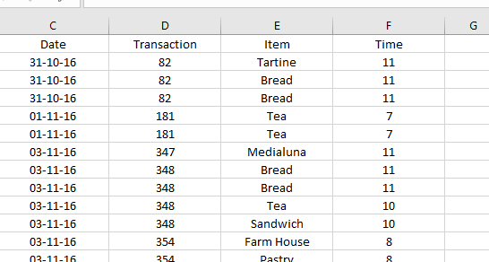
About Dataset
Contains 240 records and 4 attributes; Date, Transaction, Item, Time.
With split ratio of 0.65, dataset has been divided into training and testing data.

Slide 4
Data Preprocessing
To preprocess data, we will use scikit-learn or sklearn.
Changed time format from hh:mm:ss to hours.

Slide 5
Flow of system implemented
Confusion Matrix
65% Data
Training Data
LR Model
Models
Accuracy
Data set
KNN Model
Precision
SVM Model
Testing Data
35% Data
Recall
Testing data

Slide 6
Classification Techniques Applied
Logistic Regression
K-nearest neighbors (KNN)
Support vector machine (SVM)

Slide 7
Logistic Regression
In statistics, the logistic model is a widely used statistical model that, in its basic form, uses a logistic function to model a binary dependent variable; many more complex extensions exist.
When Logistic Regression is applied to dataset having more than two classes, then it is called Multinomial Logistic Regression.

Slide 8
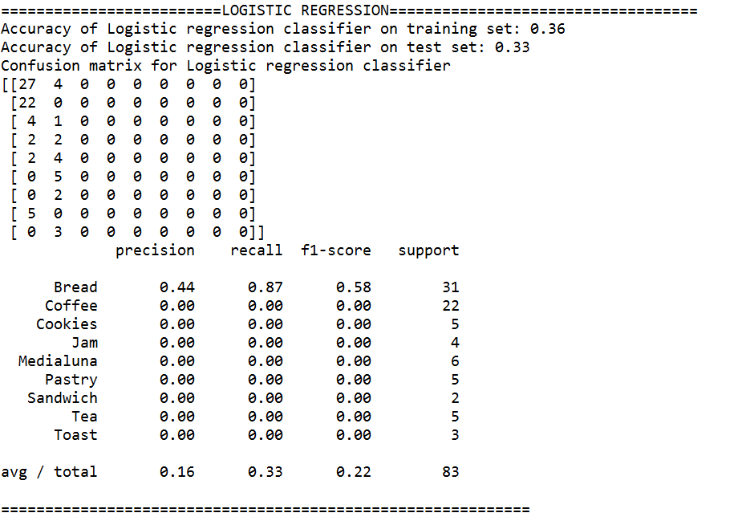
Logistic Regression Output
Confusion Matrix

Slide 9
K-nearest neighbors (KNN)
In pattern recognition, the k-nearest neighbors algorithm is a non-parametric method used for classification and regression. In both cases, the input consists of the k closest training examples in the feature space.

Slide 10
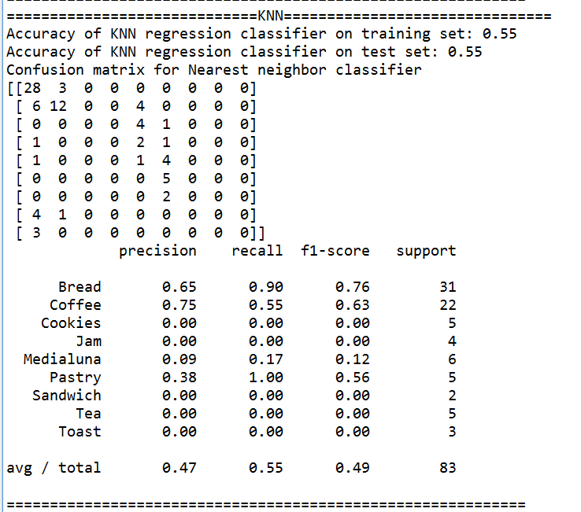
K-nearest neighbors Output
Confusion Matrix

Slide 11
Support vector machine (SVM)
In machine learning, support vector machines are supervised learning models with associated learning algorithms that analyze data used for classification and regression analysis.

Slide 12
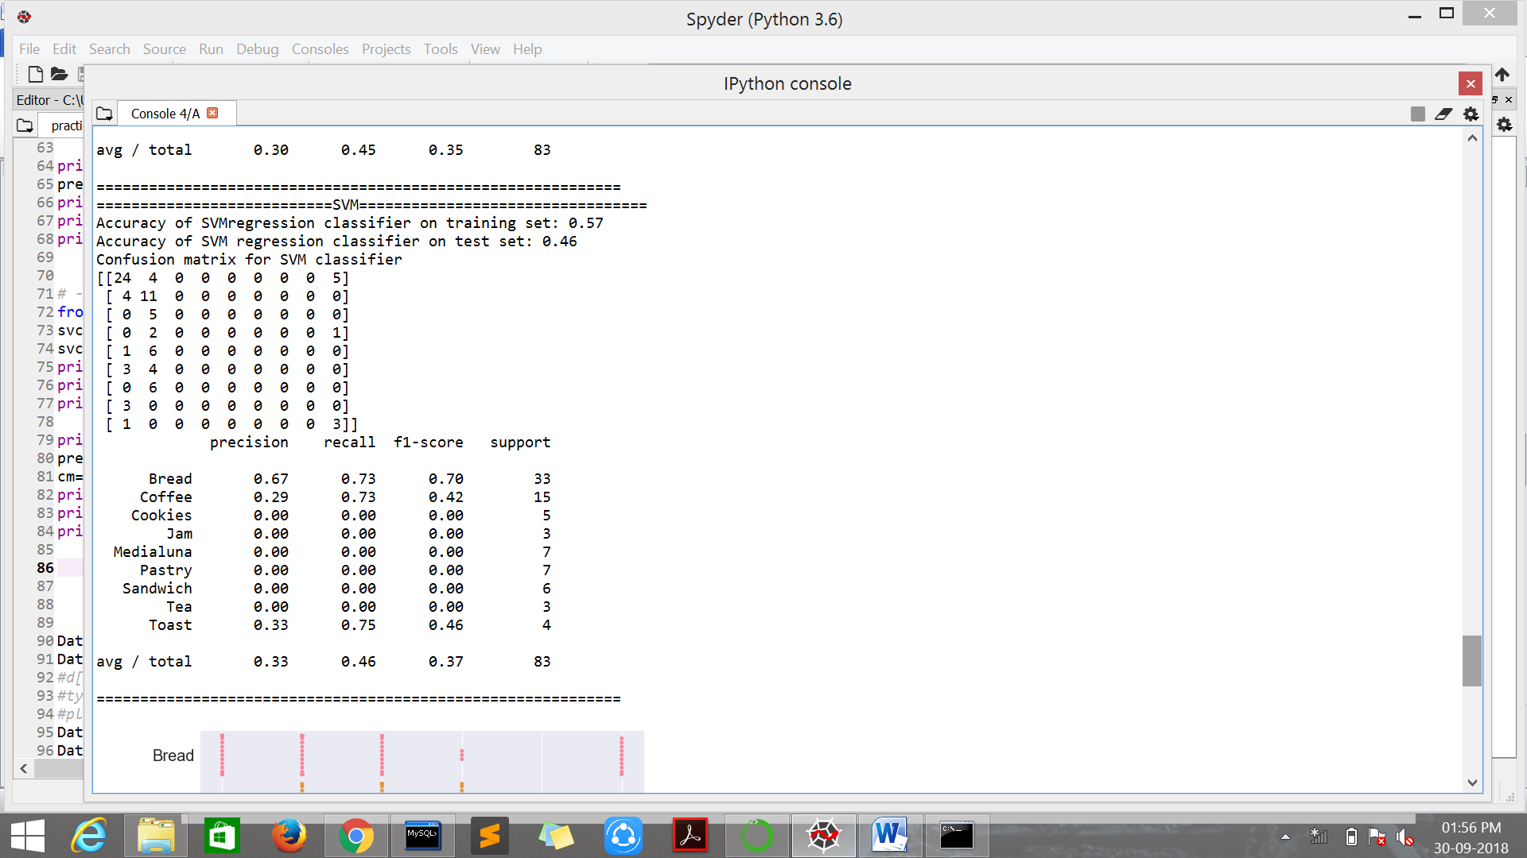
Support vector machine Output
Confusion Matrix

Slide 13
GUI
Built in R studio.

Slide 14
Countplot
This plot considers Items and transactions attributes from data set.
Classes division:
First: Transactions between 7am to 9am.
Second: Transactions between 9am to 11am.
Third: Transactions between 11am to 12am.
Items vs Transactions

Slide 15
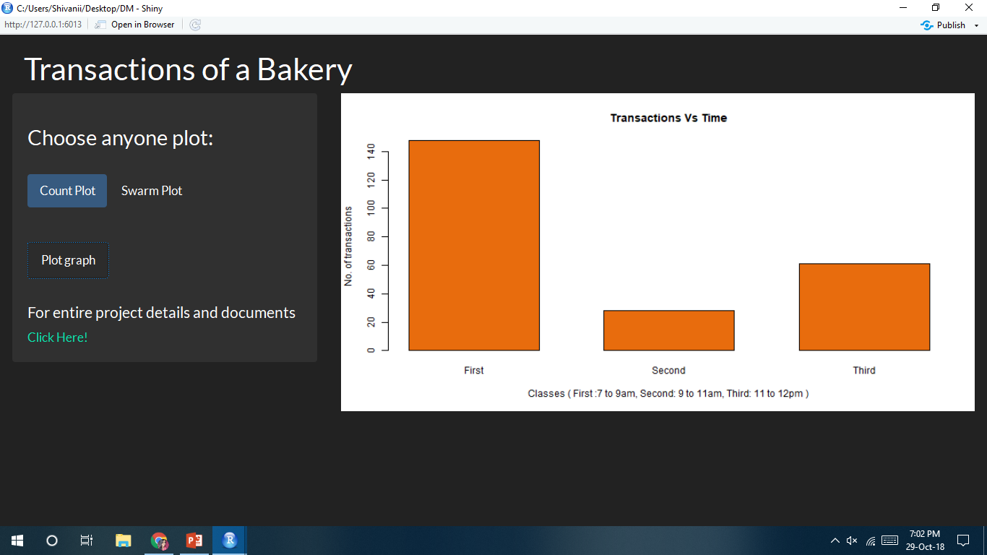

Slide 16
Swarmplot
This plot considers Items and time attributes from data set.
The plot shows an item bought at particular time with a color dot.
Eight colors represent eight different items.
Item vs Time(in hours)

Slide 17
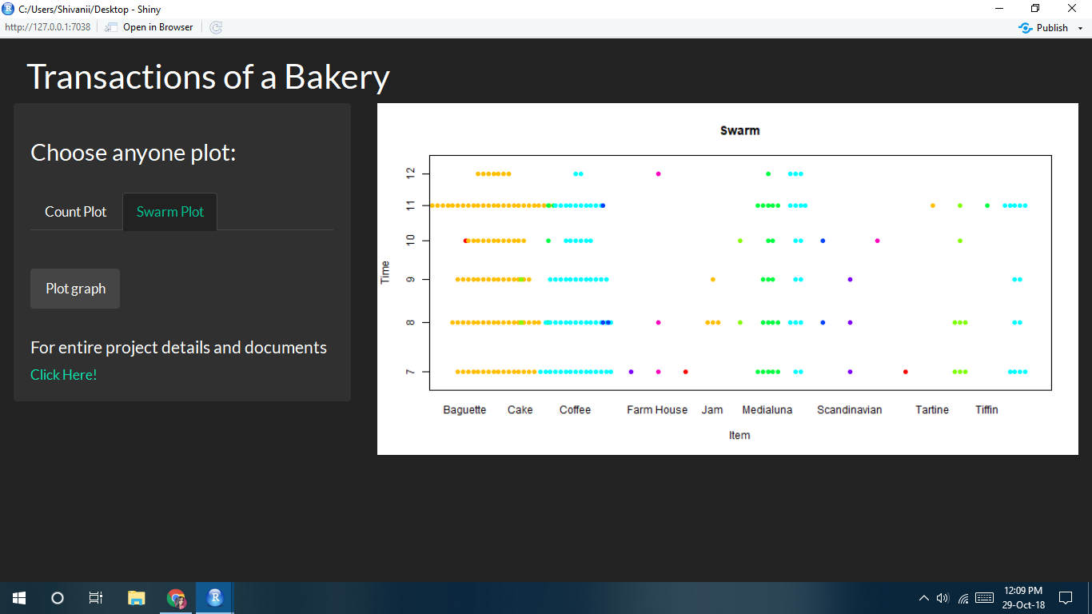

Slide 18
Technologies Used
Platforms:
Anaconda
Spyder IDE for python development
Back-end:
Python
R Language; Shiny Package
Front-end:
R

Slide 19
Thank you

